Slide 1
Task _ 01
Bytewise fellowship Flutter Track
By Urwah Shafiq

Slide 2
Introduction to Mobile Engineering
Popular Mobile OS :
1. Android (53.32% Market Share):
Key Features: Open-source, customizable, vast app selection (Google Play Store), hardware flexibility (various manufacturers).
Advantages: Cost-effective development, wider device reach, freedom for developers.
Languages/Frameworks: Java (Kotlin becoming increasingly popular), C++, Flutter (cross-platform).

Slide 3
Introduction to Mobile Engineering
2. iOS (43.98% Market Share):
Key Features: User-friendly interface, tight integration with Apple ecosystem, strong security focus, known for performance.
Advantages: Premium user base, smoother app experience, faster updates.
Languages/Frameworks: Swift (primary), Objective-C (legacy), SwiftUI (declarative UI framework).

Slide 4
Introduction to Mobile Engineering
Cross-Platform Development:
Frameworks: React Native (JavaScript), Xamarin (C#), Flutter (Dart).
Advantages: Saves development time and cost, reaches both iOS and Android users with a single codebase.
Considerations: Might have some limitations in performance or native features compared to fully native apps.

Slide 5
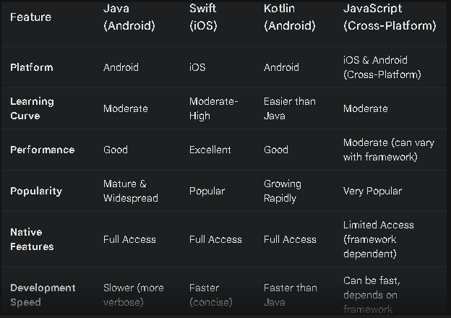
Compare and contrast mobile app development in languages like Java, Swift, Kotlin, and JavaScript

Slide 6
pros and cons of using cross-platform frameworks like Flutter, React Native, and Xamarin?
Pros:
Faster Development: Single codebase for both iOS & Android.
Reduced Cost: One developer team can handle both platforms.
Wider Market Reach: Target both major mobile OSes simultaneously.
Easier Maintenance: Updates can be applied to a single codebase.

Slide 7
pros and cons of using cross-platform frameworks like Flutter, React Native, and Xamarin?
Cons:
Performance: May lag behind fully native apps.
Limited Native Features: Framework-specific limitations compared to native access.
User Experience: Can feel less "native" on each platform.
Learning Curve: Requires knowledge of the framework on top of core languages (e.g., Dart for Flutter).

Slide 8
Advantages and Disadvantages of Using Flutter for Mobile App Development
Pros:
High Performance:
Single Codebase:
Fast Development:
Strong Support:
Backed by Google with robust community support.
5. Beautiful UIs:

Slide 9
Advantages and Disadvantages of Using Flutter for Mobile App Development
Cons:
Learning Curve:
Requires learning Dart and adapting to Flutter's architecture.
Large App Size:
Apps are typically larger compared to native counterparts.
Limited Native Features:
Some platform-specific functionalities may need custom solutions.
Ecosystem Maturity:
Fewer third-party libraries and plugins compared to more established frameworks.

Slide 10
What are the differences between native and hybrid mobile apps? Provide examples built using Flutter.
Native vs. Hybrid Mobile Apps:
Native: Built for one platform (Android/iOS) for top performance
Hybrid: Single codebase for both platforms (web tech in a native shell) for faster development and wider reach,
Flutter: Examples: Alibaba, Reflectly, The New York Times, Google Ads,

Slide 11
Analyze the performance of mobile apps built with Flutter compared to native apps.
Flutter apps: Great performance, close to native, but might be slightly larger due to framework inclusion.

Slide 12
Explain the use cases where using Flutter is good
Cross-platform apps: Develop for iOS & Android with a single codebase (saves time & money).
Beautiful UIs: Craft stunning interfaces with rich widgets.
Fast development: Hot reload speeds up development cycles.
Good performance: Enjoy smooth animations and fast rendering.

Slide 13
Use cases where using Flutter is not that good
Limited native features: Needs extra effort for very specific device functionalities.
Larger app size: Framework adds to the app's overall size.
New framework: Less mature compared to established options.

Slide 14
What is Kivy and Ionic? Why don't we use them?
Kivy & Ionic: Alternatives to Flutter?
Kivy (Python): (Python based farmwork),Good for rapid prototyping, but less mature for complex apps.
Ionic (Web technologies): (web based farmwork, HTML5,angular, CSS, JavaScript), but potentially lower performance for mobile.
We don’t use them because of their scalability and low maturity , and less community support.
https://www.loom.com/share/3ecf5a6a5a5e4382ad29e39231f03864?sid=4a62c630-7366-4cfe-85ec-d53f533be564

